Slide 1
Chapter 11: Implementing File Systems
May, 2024

Slide 2
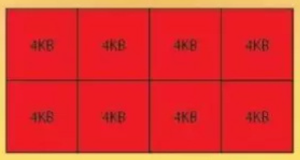
Review
Disk
Sector, page
Logical block address： LBA
0 | 1 | 2 | 3 | …

Slide 3
Review
MBR
Partition1
Partition2
file blocks

Slide 4
Review
MBR
Partition1
Partition2
block
Other management information
Directory and data
file system 1

Slide 5
A Partition
We have system calls at the API level, but how do we implement their functions?
Boot control block contains info needed by system to boot OS from that volume
Needed if volume contains OS, usually first block of volume
Volume control block (superblock, master file table) contains volume details
Total # of blocks, # of free blocks, block size, free block pointers or array
Boot block | Volume block | Directory and Data
partition
Notes:
包含OS的volume需要boot block来作为引导。

Slide 6
File System Implementation

Slide 7
Main Content
Focus on
Directory structure
Block allocation and reclaim
Free block management
Two representative FSs
FAT series
Linux ext series

Slide 8
Directory Structure

Slide 9
Directory Entry
Directory structure organizes the files
Directory entry contains all the meta-data
Per-file File Control Block (FCB) contains many details about the file
Separate meta-data from directory
name | location | date | owner | type | …
Notes:
FAT series and Ext series
简化directory，把详细信息放到FCB中

Slide 10
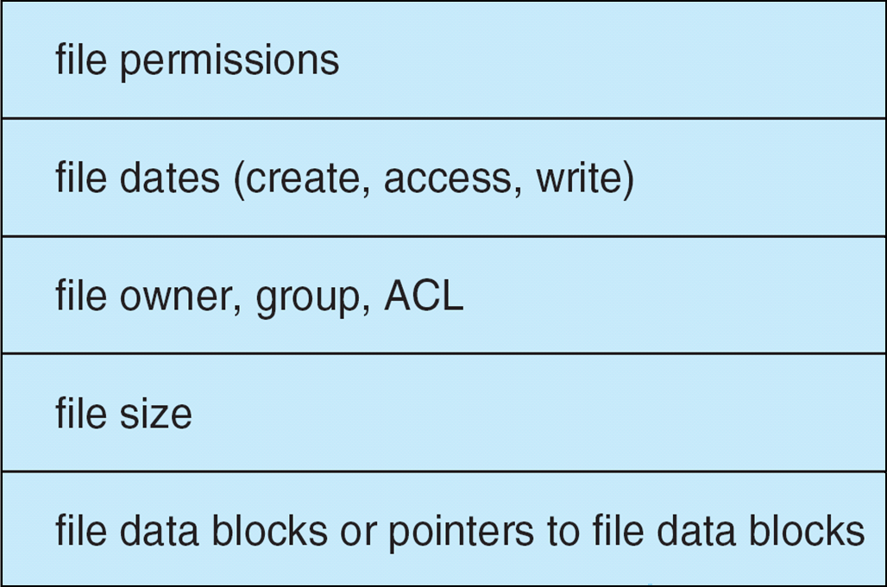
A Typical File Control Block
Directory
name | #FCB
File data
Notes:
Directory中只存FCB号就可以，FCB储存了文件的所有meta data，节省目录空间，碎片化处理
FCB通过pointer指向file data blocks

Slide 11
Implementation of Directories
Linear List
Tree
Hash tables
Notes:
目录的实现方式

Slide 12
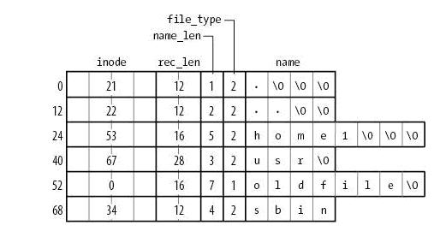
Linear list(Linux ext2)
FCB No.
Notes:
每个行代表一个directory entry，可以看到每一行的大小并不固定，主要因为name，最小也要12B

Slide 13
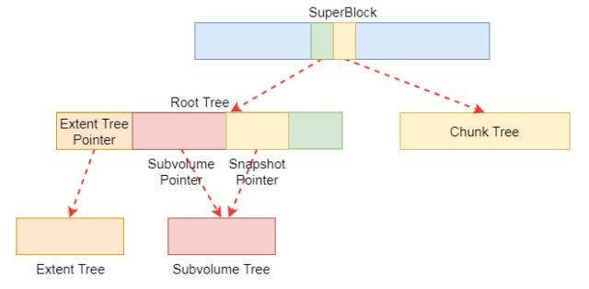
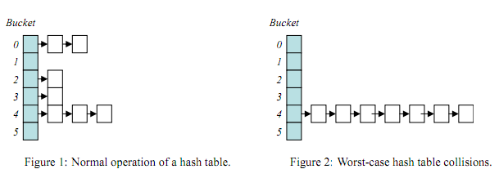
Other structures
Btrfs
Hash table

Slide 14
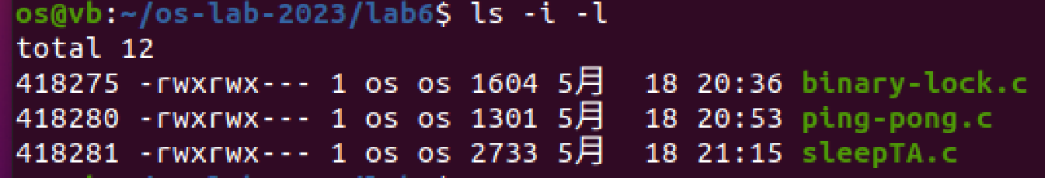
Locate A File
FCB No.
Notes:
https://www.ibm.com/developerworks/cn/linux/l-cn-btrfs/

Slide 15
Allocation Methods

Slide 16
Allocation Methods - Contiguous
An allocation method refers to how disk blocks are allocated for files（分配一个文件的blocks）
Contiguous
Linked（变体FAT类似于并查集的数据组织思想）
Indexed
Contiguous allocation – each file occupies set of contiguous blocks
Best performance in most cases
Simple – only starting location (block #) and length (number of blocks) are required

Slide 17
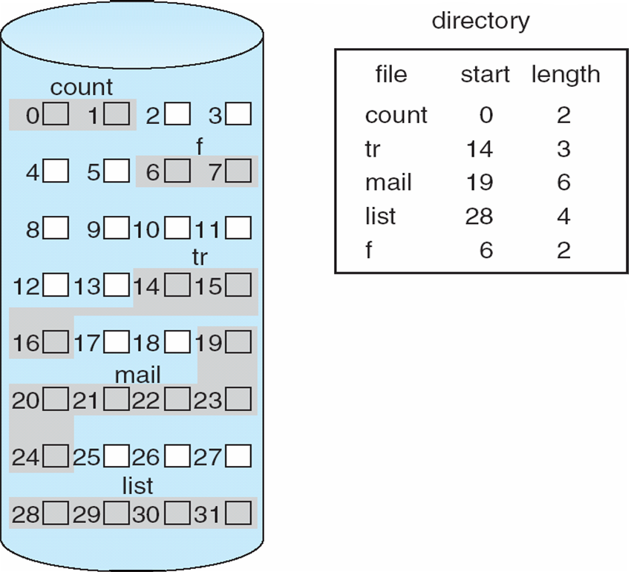
Contiguous Allocation of Disk Space

Slide 18
Allocation Methods - Contiguous
Problems include
knowing file size（难以动态增长）
external fragmentation
need for compaction（紧缩以解决外部碎片）
Notes:
可以随机访问

Slide 19
Allocation Methods - Linked
Linked allocation – each file a linked list of blocks
File ends at nil pointer（最后一个block的指针是nil）
No external fragmentation
Each block contains pointer to next block

Slide 20
Linked Allocation
Each file is a linked list of disk blocks: blocks may be scattered anywhere on the disk
pointer
block =

Slide 21
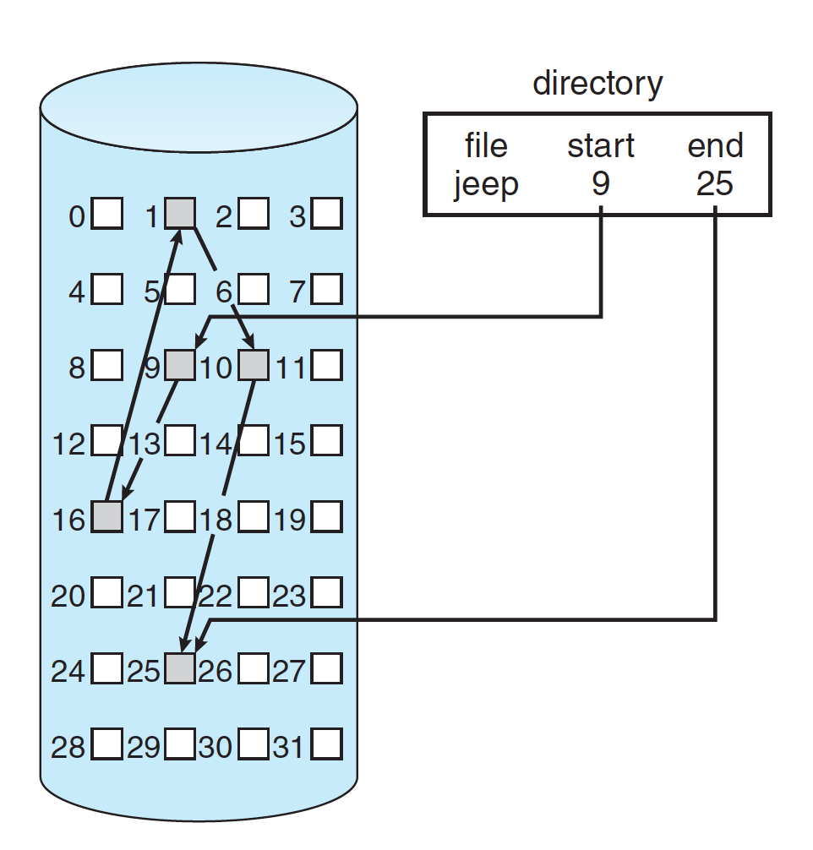
Linked Allocation

Slide 22
Allocation Methods - Linked
Linked allocation – each file a linked list of blocks
Pointer waste size
Reliability can be a problem（一个指针损坏，后面的全丢失）
Locating a block can take many I/Os and disk seeks
Sequential vs random access（无法直接访问，只能按顺序）
Notes:
要解决第2和第3个问题，即不稳定的问题和随机访问的问题，导出FAT

Slide 23
FAT (File Allocation Table) variation
FAT (File Allocation Table) variation
Beginning of volume has table, indexed by block number
Much like a linked list, but faster on disk and cacheable
New block allocation simple
Notes:
Linked方法的变种
本质是指针的聚集存储，通过内存缓存解决时间问题；通过备份解决稳定的问题（两份都在volume块中）

Slide 24
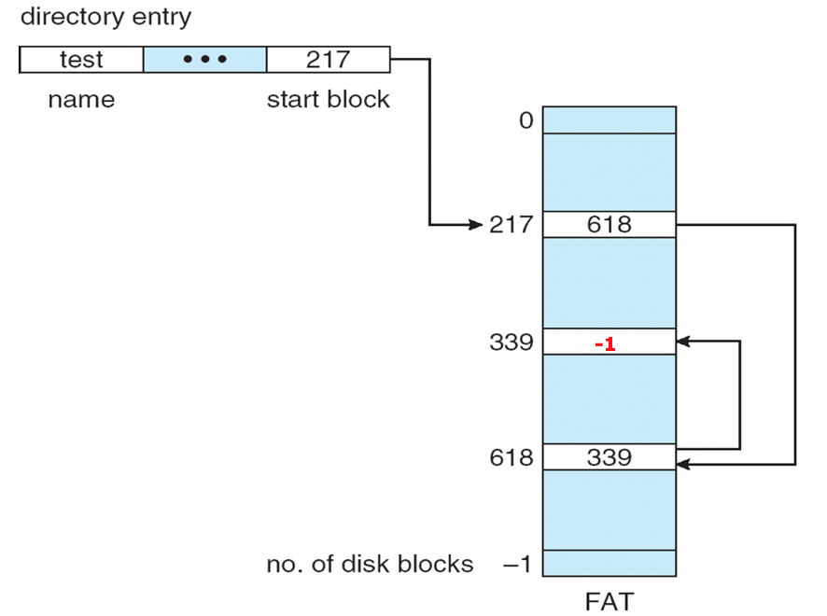
File Allocation Table
Notes:
https://www.ibm.com/developerworks/cn/linux/l-cn-btrfs/
只需要知道start block就可以，索引中存的数据是下一个索引，索引号=block号
最后一个的下一个为-1

Slide 25
Performance (Time)
Stored at the beginning of volume
Significant number of seek distance
Cached

Slide 26
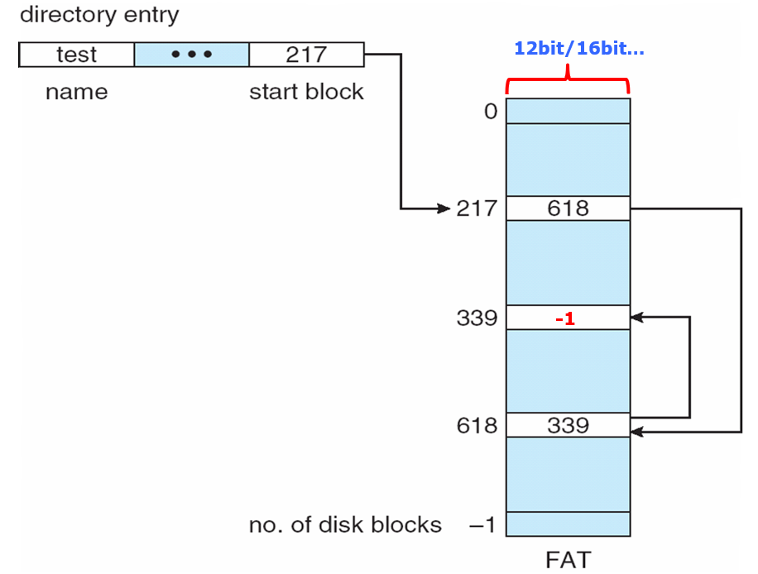
Question
FAT16
Each table entry: 16bits
Problem:
FAT table length (max?)
FAT table size (in KB, max?)
Supported disk capacity/partition size (block size 4KB)
Also the maximal file size
question
Notes:
每一行存储的是一个指针/索引，即一个行号，16bit编码的行号/整数的数目？
每一行bits转化成字节数？再乘以行数
每一个索引对应一个磁盘块，索引到的磁盘块数=索引总数=行数

Slide 27
FAT16
Assume each FAT entry is represented by 16bits
The FAT has 2¹⁶ entries
The size of the FAT is 16bits * 2¹⁶ = 2B * 2¹⁶ = 128KB
Each entry points to a 4KB block
The support disk capacity is 4KB * 2¹⁶ = 2⁸ * 2²⁰ B = 256MB

Slide 28
Allocation Methods - Indexed
Indexed allocation
Each file has its own index block(s) of pointers to its data blocks
Logical view
index table
Notes:
将fcb分离的好处，可以存下索引表

Slide 29
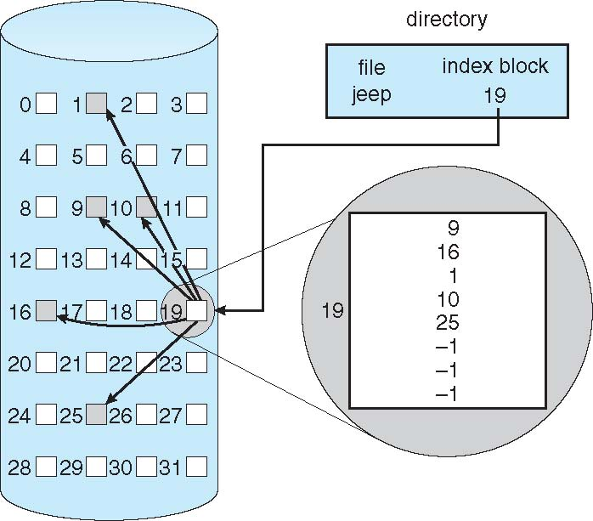
Example of Indexed Allocation
Page table
Notes:
inode, FCB
这样directory就只需要存一个索引块号

Slide 30
Indexed Allocation (Cont.)
Need index table
Random access
Dynamic access without external fragmentation, but have overhead of index block
How large an index block?
Maximal file size?

Slide 31
Indexed Allocation (Cont.)
The disk block is 4KB
Each index node occupies a block
The size of each index is 4B
What is the (max) supported file size?
Each index node has 4KB/4B = 1K entries
Each index entry points to a disk block
The supported file size by one index node is 1K*4KB=4MB

Slide 32
Multi-level index

Recall:
Page table
outer-index
index table
file
Notes:
Outer-index存储指向索引块的指针。

Slide 33
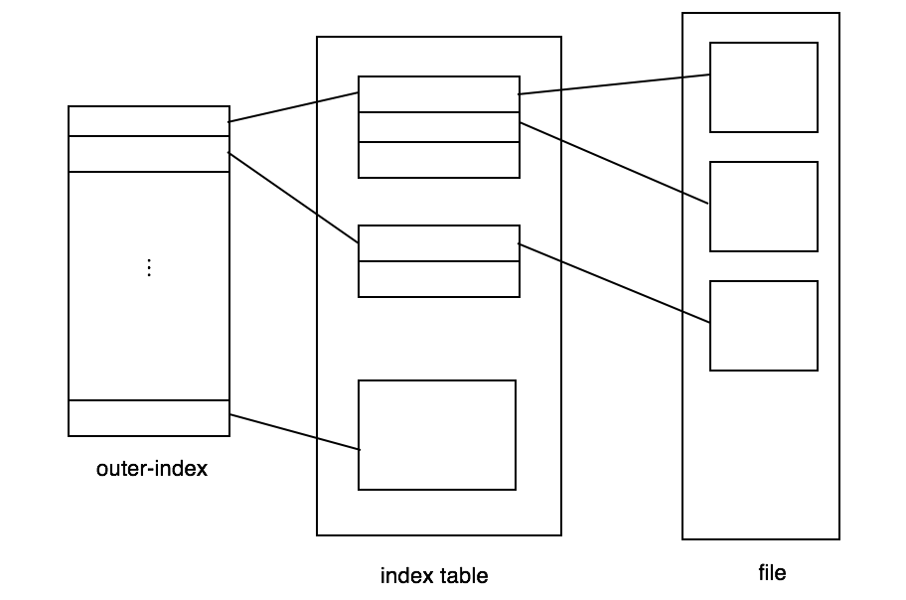
Multi-level index
The disk block is 4KB
Each index node occupies a block
The size of each index is 4B
Each index node has 4KB/4B = 1K entries
The supported file size?
The outer index node points 1K index node
Each index node points to 1K file blocks
The supported file size by one outer index node is 1K*1K*4KB=4GB
question
Notes:
With 4,096-byte blocks,
we could store 1,024 four-byte pointers in an index block. Two levels of
indexes allow 1,048,576 data blocks and a file size of up to 4 GB.

Slide 34
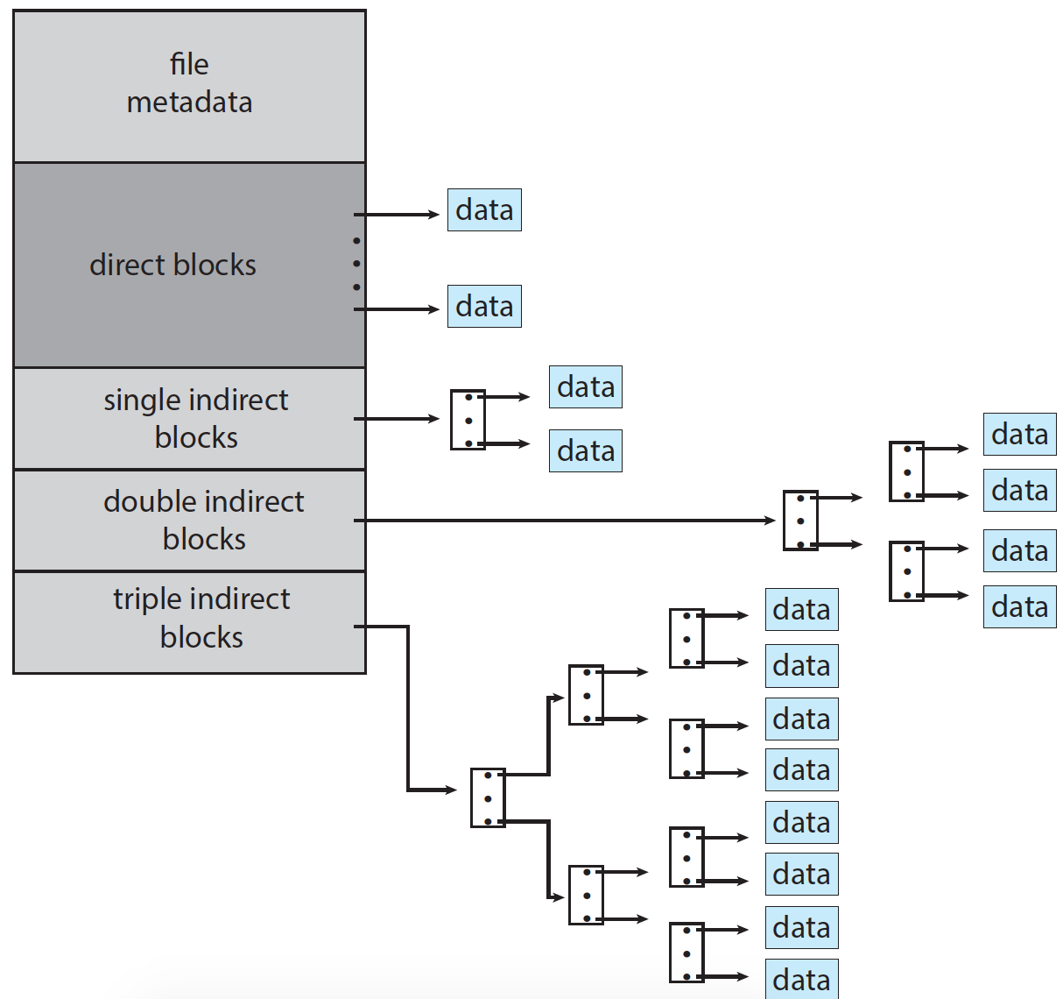
Combined Scheme: UNIX UFS
Support files with small or huge size
FCB
Notes:
Direct block有12个

Slide 35
Performance
Best method depends on file access type
Contiguous great for sequential and random
Linked good for sequential, not random（FAT can）
Indexed more complex
Double-index access could require 2 index block reads then data block read

Slide 36
Comparison: FAT vs Index Table
Boot block | Volume block | FAT | Directory | Data
Directory entry contains meta data
Each file system has 1
linked
Each file has 1
Directory entry points to FCB
Boot block | Volume block | FCBs | Directory | Data
Notes:
FAT表存在每个每个volume的起始部位

Slide 37

Comparison: FAT vs Index Table
Boot block | Volume block | FAT | Directory | Data
indexed
Directory entry contains meta data
Each file system has 1
Each file has 1
Directory entry points to FCB
Index Table
Boot block | Volume block | FCBs | Directory | Data
Notes:
索引方式使用了FCB来单独存储多级索引块号（UNIX），directory只是存了FCB的指针，图片中并非现实实现方式

Slide 38
Free Space Management

Slide 39
Management Strategy
Bitmap（位图）
Linked （链表）
FAT（file allocate table）

Slide 40
Free-Space Management: bitmap
0
1
2
n-1
…
1 ⇒ block[i] occupied
0 ⇒ block[i] free
bit[i] =

Block number calculation
(number of bits per word) *
(number of 0-value words) +
offset of first 1 bit
CPUs have instructions to return offset within word of first “1” bit
Notes:
查找第一个空闲块：也就是bit map中第一个0。
例如，如果我们有一个位图，其中包含多个word，每个word有32位，并且我们知道前n个word都是0，第一个1出现在第n+1个word的第m位，那么第一个1的位的位置可以这样计算：位置=(n×位数)+m
(number of bits per word) * (number of 0-value words) + offset of first 1 bit

Slide 41
Free-Space Management (Cont.)
Bit map requires extra space
block size = 4KB = 2¹² bytes
disk size = 2⁴⁰ bytes (1 terabyte)
The bitmap size?

Slide 42
Bitmap Size
The block size = 4KB = 2¹² B
The disk capacity is 1TB = 2⁴⁰ B
The number of blocks on the disk is 2⁴⁰ / 2¹² = 2²⁸
Each block is represented by 1bit in the bitmap
The length of the bitmap is 2²⁸
The size of the bitmap is (2²⁸ / 8) bytes = 32MB

Slide 43
Layout of A File System
Boot block | Volume block | File control blocks (FCBs) | Directories + File data
Volume/partition
(e.g. Ubuntu-ext4)
Free space management:
bitmap
Notes:
Volume block负责管理空闲空间

Slide 44
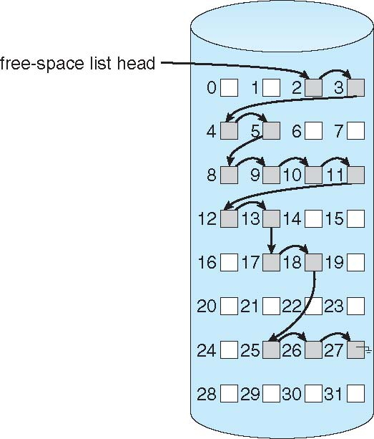
Free Space Management: Linked
No extra space needed

Slide 45
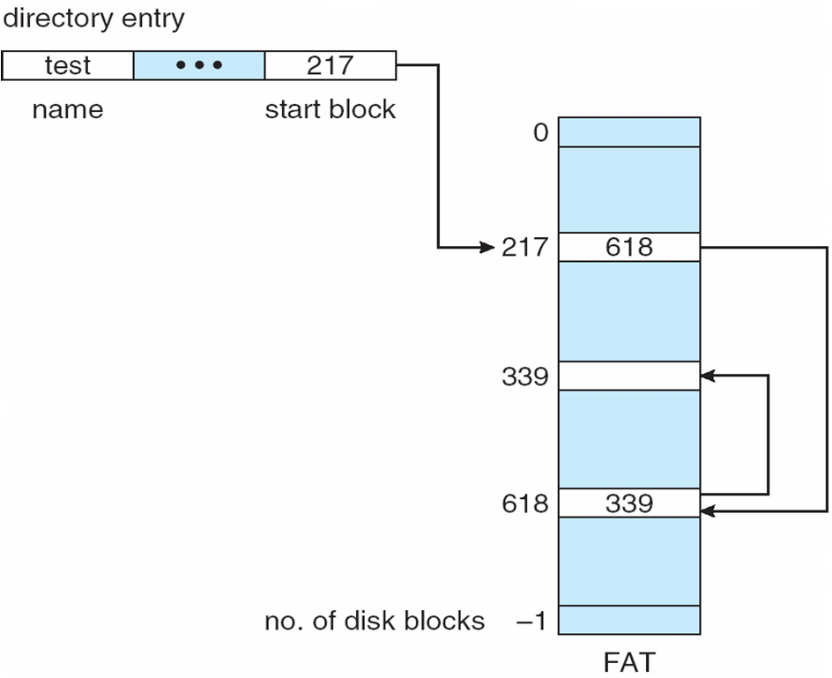
File-Allocation Table
0
-1
Notes:
FAT16, FAT32

Slide 46
Efficiency and Performance

Slide 47
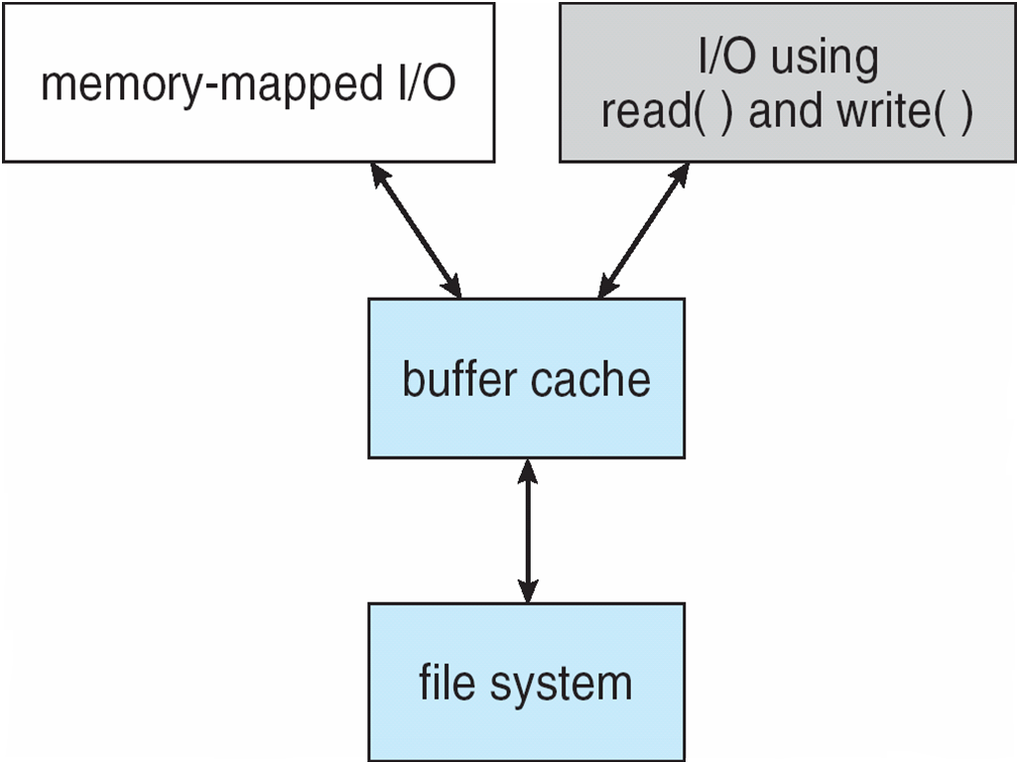
Efficiency and Performance
Performance
Onboard cache: read a track for every seek
Buffer cache – separate section of main memory for frequently used blocks
Unified buffer cache
read-ahead for sequential access

Slide 48
Efficiency and Performance
Performance
Synchronous（同步） writes sometimes requested by apps or needed by OS
No buffering / caching – writes must hit disk before acknowledgement
Asynchronous（异步） writes more common, buffer-able, faster

Slide 49
Recovery
Consistency checking – compares data in directory structure with data blocks on disk, and tries to fix inconsistencies
Can be slow and sometimes fails
Use system programs to back up data from disk to another storage device (magnetic tape, other magnetic disk, optical)
Recover lost file or disk by restoring data from backup
Delete a file

Slide 50
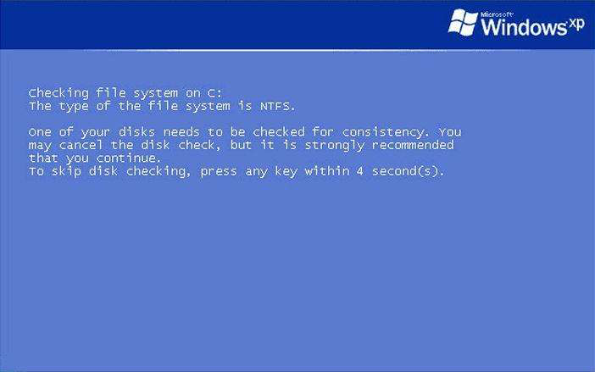
Consistency Checking

Slide 51
Log Structured File Systems
Log structured (or journaling) file systems record each metadata update to the file system as a transaction
All transactions are written to a log
A transaction is considered committed once it is written to the log (sequentially)
Sometimes to a separate device or section of disk
However, the file system may not yet be updated
If the file system crashes, all remaining transactions in the log must still be performed
Faster recovery from crash, removes chance of inconsistency of metadata
NTFS

Slide 52
End of Chapter 11

Slide 53
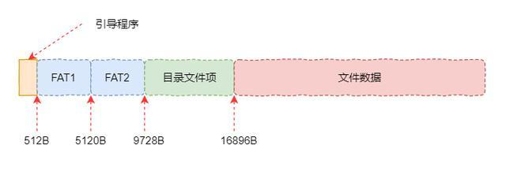
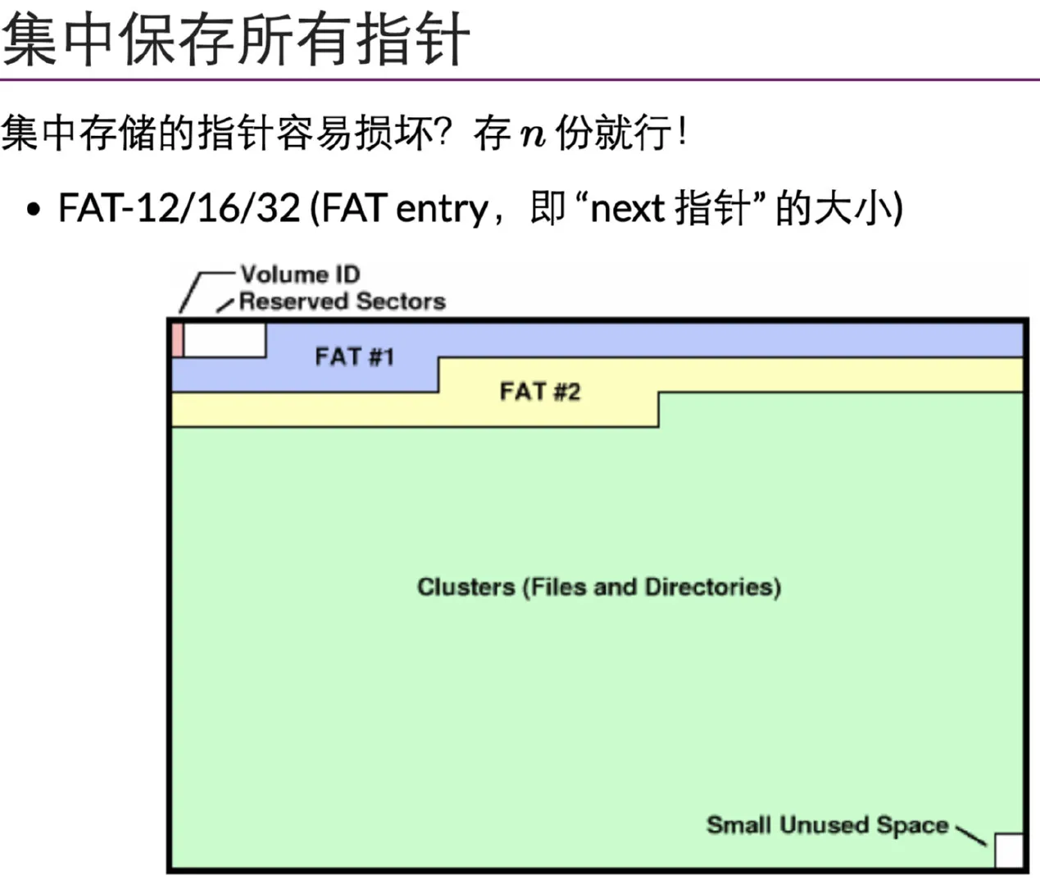
FAT文件系统的布局
Notes:
https://baijiahao.baidu.com/s?id=1671223633710589052&wfr=spider&for=pc
https://zhuanlan.zhihu.com/p/480850906
目录文件项
这里相当于FAT文件系统的根目录。所有的文件或者目录都要以这里为起始位置。这里每个文件或者目录都是通过下面这个结构图描述的。这里面包含文件名称，扩展名，文件属性和文件的数据位置等内容。
上述数据结构与Linux中的inode类似，可以看出每一项占用32字节的空间。这样磁盘布局中的目录文件项空间就可以细化成下图这样。其中每一个方块代表上图中的一个数据结构。这个数据结构里面比较重要的内容是文件名和文件数据的首地址。

Slide 54
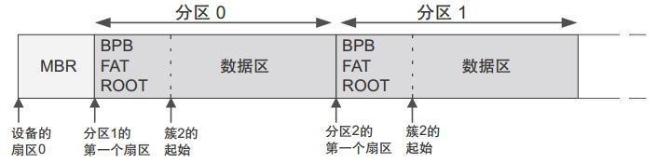
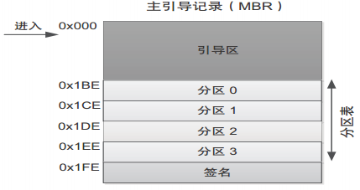
FAT文件系统的布局
Notes:
2.1 MBR
主引导记录 （ MBR）位于设备物理起始位置上的一个或多个扇区。
1. MBR 的引导区包含 DOS引导加载程序代码，该代码会在设备格式化后被写入 （否则不会被动态 C FAT 文件系统所使用）。
2. 引导区之后是分区表。分区表中含有四个 16 字节的条目，允许设备划分多达四个分区。 分区表条目中含有一些关键信息：分区类型 （动态 C FAT 可识别 FAT12 和 FAT16 的分区类型）以及分区的起始与结束扇区号。
另外还有一个字段指明分区中的扇区总数。如果该数字为零，则对应的分区是空的可用分区
2. 2 FAT分区
FAT分区主要包含如下几部分信息：
1. BPB 参数块（启动分区块？） BPB 中的字段包含该分区的描述信息： • 每个扇区的字节数； • 每个簇的扇区数； • 该分区的扇区总数； • 根目录下的条目数。 2. FAT 分配表 文件分配表是一种结构，也是 FAT 文件系统的命名由来。 FAT 中保存了关于簇的分配信息。 一个簇既可以分配给一个文件，也可以使用，还可以标记为坏簇。 FAT 分配表的副本会紧跟 着第一个 FAT 分配表存放。 3.根目录 根目录具有预定义的位置及大小。根目录有 512 个条目，每个条目 32 字节。根目录中的条目 既可以是空条目，也可以包含文件或子目录名称（以 8.3 格式）、文件大小、上一次修改的日 期时间以及文件或子目录的起始簇号。 4.数据区 数据区占据了分区中的大部分空间。其中包含文件数据与子目录。请注意，按照惯例，分区 的数据区必须从第 2 簇开始。欲了解更多信息，请参考 Microsoft® EFI FAT32 文件系统规范
3.参考文献
[1] 在 STM32Cube 上开发 FatFs 相关应用.pdf

Slide 55
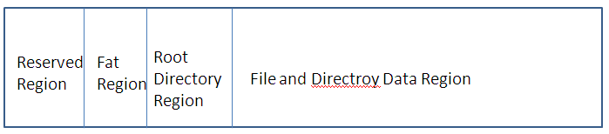
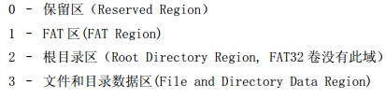
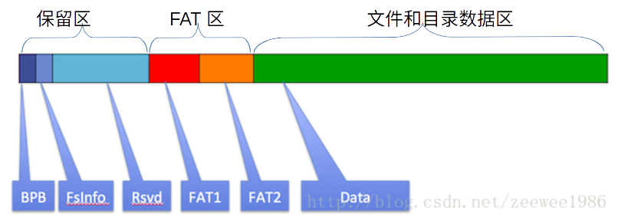
FAT文件系统的布局
Notes:
https://www.cnblogs.com/smartjourneys/p/8413616.html

Slide 56
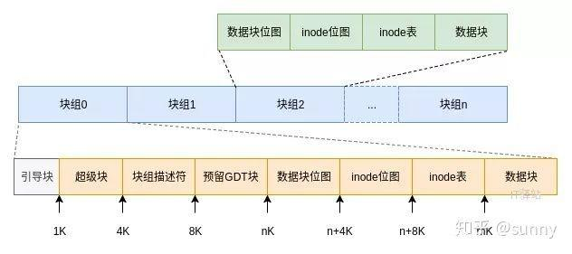
Ext2文件系统的布局
Notes:
ext2有一些保留的inode，比如2用于根目录

